Slide 1
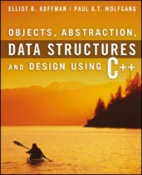
Welcome to
CS 235 Data Structures
C++ Primer (02)
P.1, pgs. 2-7

Slide 2
What’s Not To Like?
if ( LineStatus == LINE_OPEN ) {
while ( CheckLineLevel() == LEVEL_OK )
{
while ( (Ch = ReadLine()) != EOF )
{
if ( Ch == CH_REVERSE) {
ReverseLine();
}
}
}
}
Brace layout is the most noticeable element of the style of a C++ program.
It is arguable that braces are an 'unnecessary' part of the layout and that indentation alone is enough to show nesting.
Against this is the argument that braces follow the principle of explicitness in laying out a block, clearly showing the start and the end.
There are several common styles of brace usage which can cause significant confusion if mixed!
http://syque.com/cstyle/contents.htm

Slide 3
Tip #02: Braces
if ( PageWidth > PaperWidth ) {
SetPageWidth( PaperWidth );
TellUser( MSG_PAGE_CHANGED );
}
if ( PageWidth > PaperWidth ||
PageWidth < PG_MIN_WIDTH ||
IsNewDocument() ) {
SetPageWidth( PaperWidth );
TellUser( MSG_PAGE_CHANGED );
}
Kernel Style
if ( PageWidth > PaperWidth )
{
SetPageWidth( PaperWidth );
TellUser( MSG_PAGE_CHANGED );
}
if ( PageWidth > PaperWidth ||
PageWidth < PG_MIN_WIDTH ||
IsNewDocument() )
{
SetPageWidth( PaperWidth );
TellUser( MSG_PAGE_CHANGED );
}
Allman Style
if ( PageWidth > PaperWidth )
{
SetPageWidth( PaperWidth );
TellUser( MSG_PAGE_CHANGED );
}
if ( PageWidth > PaperWidth ||
PageWidth < PG_MIN_WIDTH ||
IsNewDocument() )
{
SetPageWidth( PaperWidth );
TellUser( MSG_PAGE_CHANGED );
}
Whitesmiths Style
http://syque.com/cstyle/contents.htm

Slide 4
Brace Styles
Brace placement | Style
while (x == y) { something(); somethingelse(); } | K&R
Brace placement | Style
while (x == y) { something(); somethingelse(); } | Horstmann
while (x == y) { something(); somethingelse(); } | Allman
while (x == y) { something(); somethingelse(); } | Pico
while (x == y) { something(); somethingelse(); } | Whitesmiths
while (x == y) { something(); somethingelse(); } | Ratliff
while (x == y) { something(); somethingelse(); } | GNU
while (x == y) { something(); somethingelse(); } | Lisp

Slide 5
◆ To understand the essentials of object-oriented programming in C++
◆ To understand how to use the control structures of C++
◆ To learn about the primitive data types of C++
◆ To understand how to use functions in C++
◆ To understand how to use pointer variables in C++
◆ To understand how to use arrays in C++
◆ To learn how to use the standard string class
◆ To learn how to perform I/O in C++ using streams
C++ Primer Objectives:
C++ Primer Goals

Slide 6
Why C++?
Answer this
do you want to be a world-class developer working on really interesting stuff...
or, do you just want to make some money while coding routine tasks with some CurrentlyPopularJSFramework?
No one says you should code some website’s front-end with C++. It’s your choice, but remember this,
JavaScript runs on engine written in C/C++ (f.i. Google V8),
.NET Framework CLR is written in C++,
MS Windows is written in C/C++.
Apple OS X is written in C/C++.
Java JVM is written in C++,
MongoDB, Redis, web-browsers, Linux, MySQL, Adobe Photoshop, Illustrator, Nginx, OS X are written in a mix of languages, but a few important parts are C++,
Google internal/external products (including Google Search), Microsoft Visual Studio, even C# compiler itself is written in C++.

Slide 7
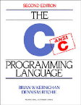
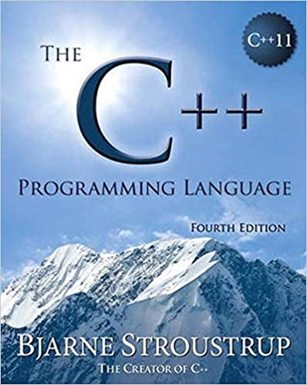
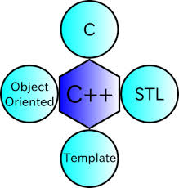
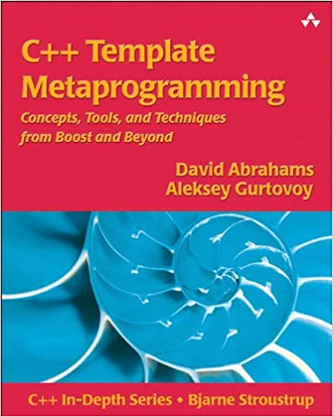
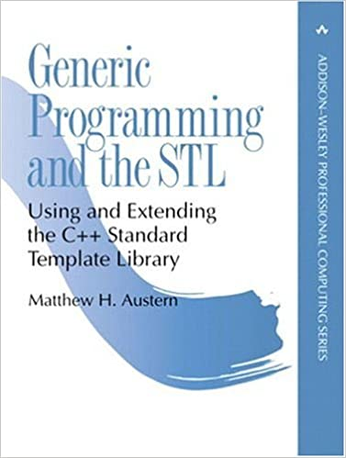
C++ is a Federation of Languages
C
Blocks, statements, preprocessor
Data types (weak), arrays, pointers
Object-Oriented C++
Classes (constructors, destructors)
Encapsulation, inheritance
Polymorphism, virtual functions (dynamic binding)
Template Metaprogramming (TMP)
Generic programming part of C++
“Compile-time execution”
STL
Containers, iterators
Algorithms, function objects
Built around templates and libraries

Slide 8
Moving From Python to C++
Main Differences:
C++ is a static (strongly) typed language that is closer to C or Java, while Python is a flexible or dynamic (weakly) type language.
Unlike Python you will be forced to declare Variables, Arrays, and other Data Structures with a type.
C++ will have you dealing with memory allocation whereas Python takes care of this for you, which means you will need to learn more about memory and pointers and a bunch of stuff that stems from lower level programming languages.
The sum of the first two differences are the main reason C++ is so fast!
C++ also focuses on OOP (object oriented programming) more than Python.
Both C++ and Python are C family languages (C++ is specifically an extension of the C language), which means they share the same general syntax.
Finally, you're not "switching" from Python to C++ as a great many C++ programmers also use scripting languages, and Python is one of the very best companions because of its easy and simple object orientation.
https://www.learncpp.com

Slide 9
P.1 The C++ Environment
Include Files
The Preprocessor
The C++ Compiler
The Linker
Functions, Classes, and Objects
The #include Directive
The using Statement and namespace std
Function main
P.1 The C++ Environment

Slide 10
Algorithm
Step by Step Procedure
Algorithm
Finiteness
Must terminate.
Definiteness
Each step is precisely stated.
Effective Computability
Each step can be carried out.

Slide 11
Algorithm
Step by Step Procedure
Algorithm
Systematic Decomposition
Start with problem statement:
Decompose each task into a few simpler subtasks.
Decompose each subtask into smaller subtasks and these into even small subtasks, etc.
Repeat until you get to computer instruction level.

Slide 12
Lab 00 – Hello World
L00 – Hello World!

Slide 13
Lab 00 – Hello World
Run Visual Studio Community (or IDE of choice) and create an empty project.
Add the C++ .cpp file (or write your own) to your project.
#include <iostream>
#include <fstream>
#include <string>
using namespace std;
int main(int argc, char* argv[])
{
if (argc < 3) return 3;
ifstream in(argv[1]);
if (!in) return 1;
ofstream out(argv[2]);
if (!out) return 2;
string line;
while (getline(in, line));
{
out << line << endl;
}
in.close();
out.close();
return 0;
}
Set breakpoint on return to verify message.
Compile and execute.
Zip your hello.cpp file.
Submit the .zip folder.
Verify auto-grader results.
Memory leak - failure to correctly deallocate memory that was previously allocated.
Particularly serious issue for programs like daemons and servers which never terminate.
Among the most subtle and hard-to-detect bugs.
As such, all labs are required to be free from memory leaks.
Set Breakpoint

Slide 14
Be Safe

